Slide 1


Trees

Slide 2
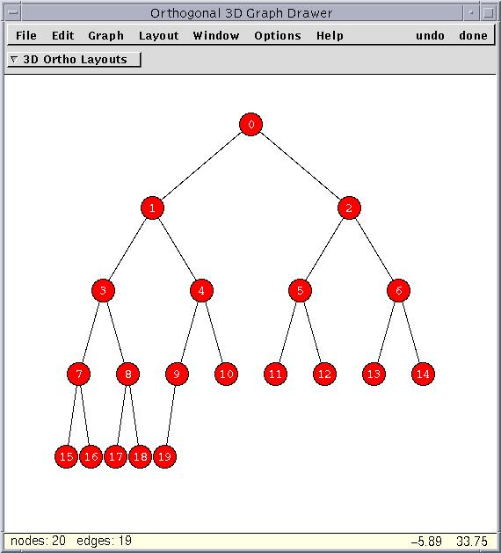
Trees
Trees are very important and useful
They are usually drawn upside-down
The allow us to represent hierarchy
File system
Book structure
Employees in a bureacracy
Definition
set of nodes and a set of directed
edges that connect the nodes
Every node has exactly one parent (except the root)
A unique path traverses from the root to each node

Slide 3
Tree Terminology
Parent / Child
The parent of a node is the node linked above it
If node u is the parent of node v, then v is the child of u
Except for the root (no parent), every node has exactly one parent
u
v
Adapted from http://www.oopweb.com/Algorithms/Documents/PLDS210/VolumeFrames.html

Slide 4
Tree Terminology
Siblings
Two nodes that are children of the same parent.
Adapted from http://www.oopweb.com/Algorithms/Documents/PLDS210/VolumeFrames.html

Slide 5
Tree Terminology
Leaf (External node)
A node is a leaf if it has no children
Adapted from http://www.oopweb.com/Algorithms/Documents/PLDS210/VolumeFrames.html

Slide 6
Tree Terminology
Internal node
A node is internal if it has one or more children
Adapted from http://www.oopweb.com/Algorithms/Documents/PLDS210/VolumeFrames.html

Slide 7
Tree Terminology
Ancestor / Descendent
An ancestor of a node is either the node’s parent or any ancestor of the node’s parent (this is recursive)
The root is an ancestor of each other node
u
u
v
v
Adapted from http://www.oopweb.com/Algorithms/Documents/PLDS210/VolumeFrames.html

Slide 8
Tree Terminology
Subtree
The subtree of T rooted at node v is the tree consisting of all the descendents of v in T (including v)
v
v
Adapted from http://www.oopweb.com/Algorithms/Documents/PLDS210/VolumeFrames.html

Slide 9
Binary Tree
The simplest form of tree is a Binary Tree
A Binary Tree consists of
(a) A node (called the root node) and
(b) Left and right subtrees
Both the subtrees are themselves binary trees
Note: this is a recursive definition
A node can’t have more than 2 children
Binary tree

Slide 10
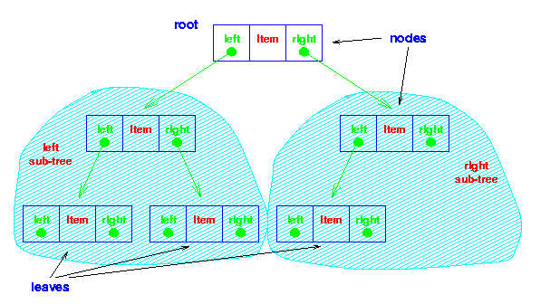
Binary Tree
Adapted from http://www.oopweb.com/Algorithms/Documents/PLDS210/VolumeFrames.html

Slide 11
Tree Terminology
Proper tree
A binary tree is proper if every node has either 2 or 0 children
all internal nodes have exactly 2 children
Full tree
A tree (binary or otherwise) is full if it’s proper and every leaf is the same distance from the root
Proper tree
Improper tree
Full tree

Slide 12
Tree Terminology
Depth of a node
The depth of a node v in T is the number of ancestors of v, excluding v itself.
If v is the root, the depth of v is 0
Otherwise, the depth of v is one plus the depth of the parent of v
v
depth of v = 1
depth of v = 3
v

Slide 13
Tree Terminology
Height (or depth) of a tree
The depth of a tree is the maximum depth of any of its leaves
tree depth = 3
tree depth = 2
tree depth = 0
Adapted from http://www.oopweb.com/Algorithms/Documents/PLDS210/VolumeFrames.html

Slide 14
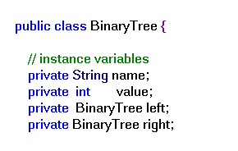
Our Binary Tree
Defined recursively as consisting of
Data (in this example: int and String, but can be anything!)
A leftHand Binary Tree
A rightHand Binary Tree

Slide 15
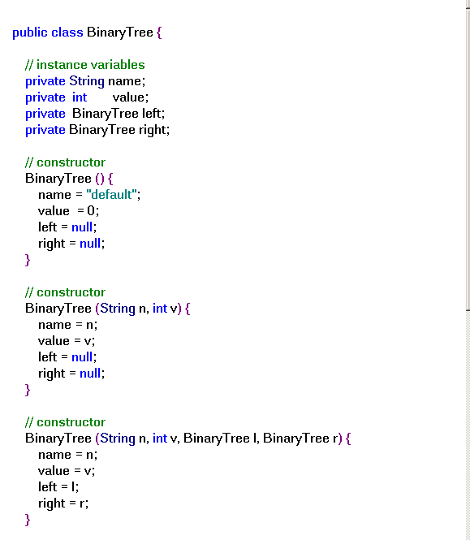
Simple Binary Tree Code

Slide 16
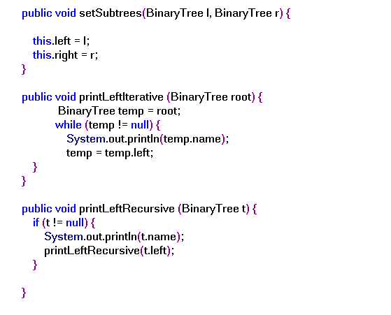

Slide 17
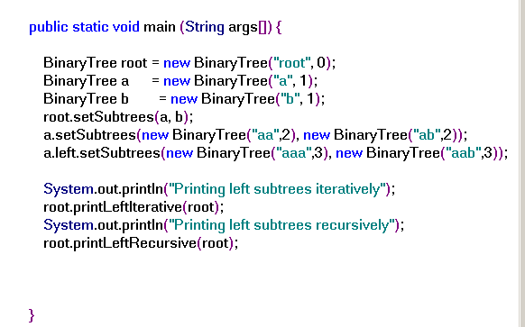

Slide 18
Tree Traversal
To process all the nodes in a tree, applying the same operation to each node
Preorder
Inorder
Postorder
All defined in terms of
When do you visit the node itself
When do you visit the lefthand side
When do you visit the righthand side
root
a
b
aa
ab
aaa
aab

Slide 19
PreOrder
root
a
b
Printing Preorder
root
aa
ab
a
aa
aaa
aab
aaa
aab
ab
b
Textual representation of the tree (parents before children)

Slide 20
PostOrder
The root is processed after its subtrees
Printing InOrder
aaa
root
aab
a
b
aa
ab
aa
ab
a
b
aaa
aab
root
Computing a property of a node depends on the nodes below it.

Slide 21
InOrder
Only change is that the root is processed in between the processing of its two subtrees
root
Printing InOrder
aaa
a
b
aa
aab
aa
ab
a
ab
aaa
aab
root
Why? Useful for searching in ordered trees
b

